Slide 1
The Demand and Supply of Resources
14
Notes:
Pre-class music: “Skipper Dan” by Weird al Yankovic (See Tip #490)
This song deals with choice and competition in the labor market. You can follow up this song by discussing with your students the implications of choosing majors for which future job prospects might be poor.

Slide 2
Previously—1
Oligopoly structure
  A small number of firms; market is concentrated
  Products may be differentiated
  Barriers to entry
Oligopoly performance
  Wide range: from competition to monopoly
Game theory
  Used to model situations where there is mutual interdependence
  Dominant strategies and Nash equilibrium

Slide 3
Previously—2
Cooperation unstable in one-shot games, but may succeed if game is repeated.
Antitrust policies
  Restrain excessive market power
  Each industry examined on a case-by-case basis

Slide 4
Big Questions
What are the factors of production?
Where does the demand for labor come from?
Where does the supply of labor come from?
What are the determinants of demand and supply in the labor market?
What role do land and capital play in production?
Notes:
Lecture tip:
You may want to point out that we are now switching from discussing output markets to input markets.
For the most part we will focus on labor markets.

Slide 5
The Factors of Production
Factors of production
  Inputs used in the production of goods and services
  Land, Labor, Capital
Derived demand
  Demand for inputs used in production
  Derived because the factors are inputs used to supply a good in another market
Notes:
Lecture notes:
Notes about derived demand:
Imagine if you were the owner of a pizza restaurant.
How do you consider your demand for labor? How do you consider how much labor to employ?
You do not say: “Workers are good. I’ll hire workers because I think the benefit is greater than the cost.”
The firm doesn’t “consume” labor like we consume food or clothing.
The firm DOES say: “How popular is my pizza? What is the demand for my pizza? How many workers will I need to produce the amount of pizza demanded?”
That is derived demand.
The amount of workers you demand is derived from the demand for the product they create.

Slide 6
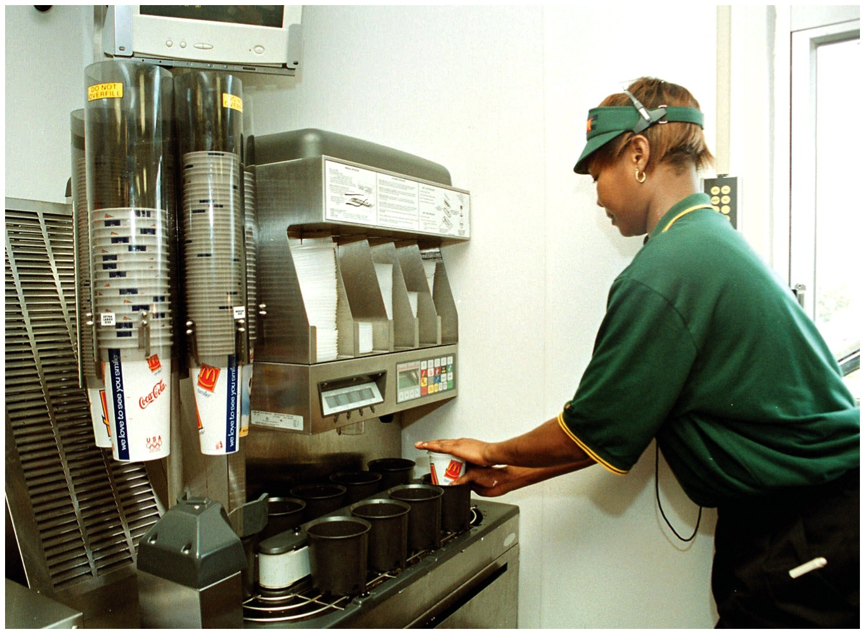
An Overview of Labor Markets
In the labor market
  Individuals are suppliers (sellers) of labor
  Firms are demanders (purchasers) of labor
  The price of labor is the wage rate
  We will use supply-demand analysis to see how wages are determined.
Notes:
Lecture tip:
Begin by asking students some questions about labor markets that you will discuss later. For example:
Why do economists earn more than elementary school teacher (or marketing majors, if you have mainly business students)?
You may have to remind students that the labor market may seem “backward” at first since they are the suppliers of labor and the firms are the demanders of labor.
Firms buy labor that you supply to them.
The price of labor is the wage rate paid in exchange for the service of labor.
Before we can answer these questions, we first need to explain where the demand and supply for labor comes from.
[AP Photo/The Daily Dispatch, Ashley Steven Ayscue]

Slide 7

Where Does the Demand for Labor Come From?—1
Marginal product of labor (MPL)
  The change in output associated with hiring one additional worker
  Remember that the MPL will eventually diminish.
Notes:
Lecture notes:
The next two slides define the terms used in the following example.
The intuition of diminishing MPL was discussed previously in Chapter 8. As more of a variable input (labor) is added to a fixed input (capital), the marginal product of the variable input will eventually start to diminish.
Think about “too many cooks in the kitchen.”
Regarding the picture on the slide:
A computer station probably has very rapidly diminishing MPL.
A second person standing there won’t create much additional output if there is just one computer.

Slide 8
Where Does the Demand for Labor Come From?—2
Value of the Marginal Product (VMP)
  MPL multiplied by the price of the output it produces
  Deli example:
    You hire a worker who can make 10 sandwiches
    You sell a sandwich for $6
    The VMP = ?
  A firm will hire a worker as long as:
$6 x 10 = $60
VMP ≥ Wage
Notes:
Lecture notes:
VMP is also called MRP (marginal revenue product). Think of this as the amount of revenue each additional worker can generate.
Labor demanded by the firm depends on the value of the marginal product that is produced. If a worker doesn’t generate enough revenue, the firm won’t hire that worker.

Slide 9
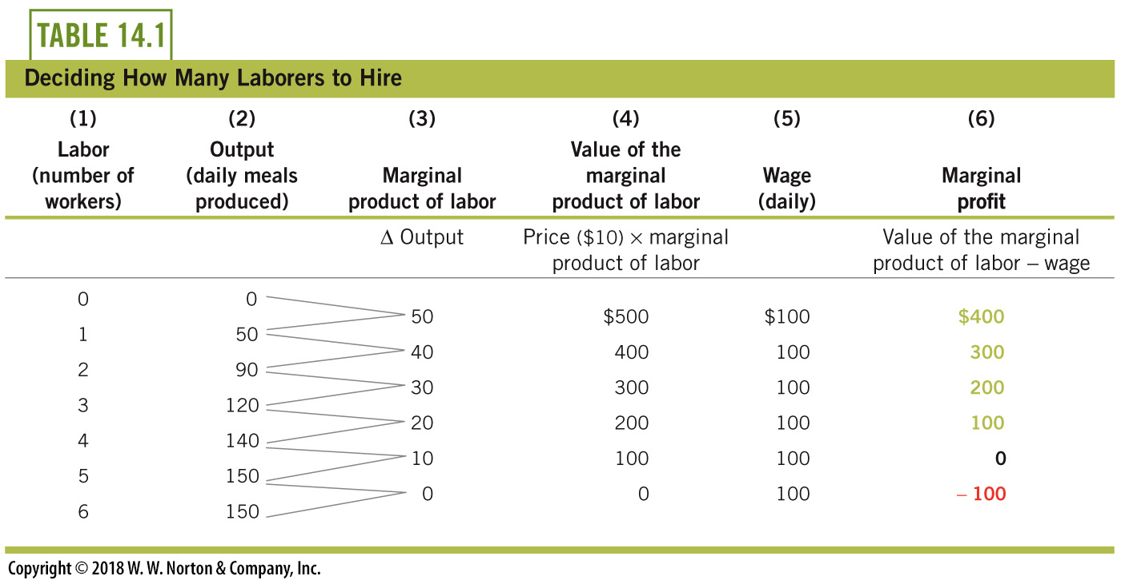
Deciding How Many Laborers to Hire—1
Notes:
Lecture tip:
Click through the slide so that the missing elements in the table appear.
Price of the good being sold is P = $10.
First, explain the three columns with data before clicking through.
First click:
Adds the MPL’s.
Ask students where diminishing returns sets in (with the third worker).
Second click:
Adds the VMPL’s: P = $10
Third click:
Adds the Marginal Profit Column
How many workers will the firm hire?
5. At this point the VMPL is just equal to the wage paid.
Why hire the fifth worker if her marginal profit is $0?
Could hire the worker part-time.

Slide 10
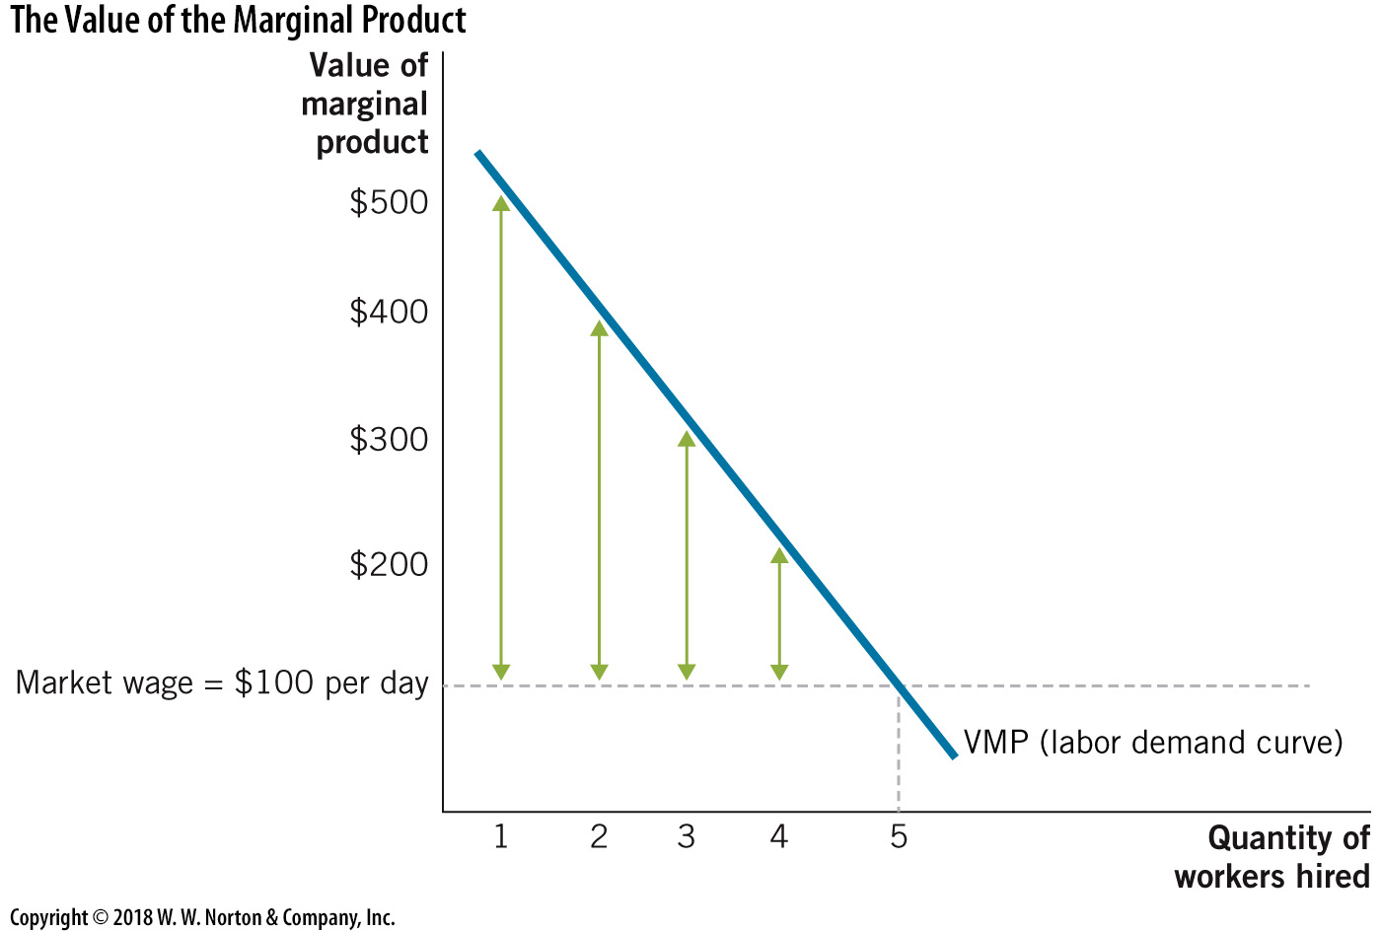
Value of the Marginal Product
Notes:
Image: Figure 14.1
Lecture notes:
The figure on the slide plots the value of the marginal product (VMP) from the previous table.
The curve looks similar to a demand curve.
The VMP is the firm’s willingness to pay for each laborer; in other words, it is the firm’s labor demand curve.
The VMP curve slopes downward due to diminishing marginal product.
Lecture tip:
Ask students: Looking at the picture, why would you hire the first worker? The second worker? etc.

Slide 11
Changes in the Demand for Labor
What two factors will change the demand for labor?
Change in the demand for the product the firm produces.
Change in the cost of producing the product.
Notes:
Lecture notes:
Why would the demand for your product increase? A few possible reasons:
The price of a competitor’s product increases.
The price of a complement good to your product decreases.
People just like your good more (change in tastes).
Why would the cost of production increase? A few possible reasons:
A change in technology (will discuss costs and benefits of in a few slides)
A change in the cost of a resource.

Slide 12
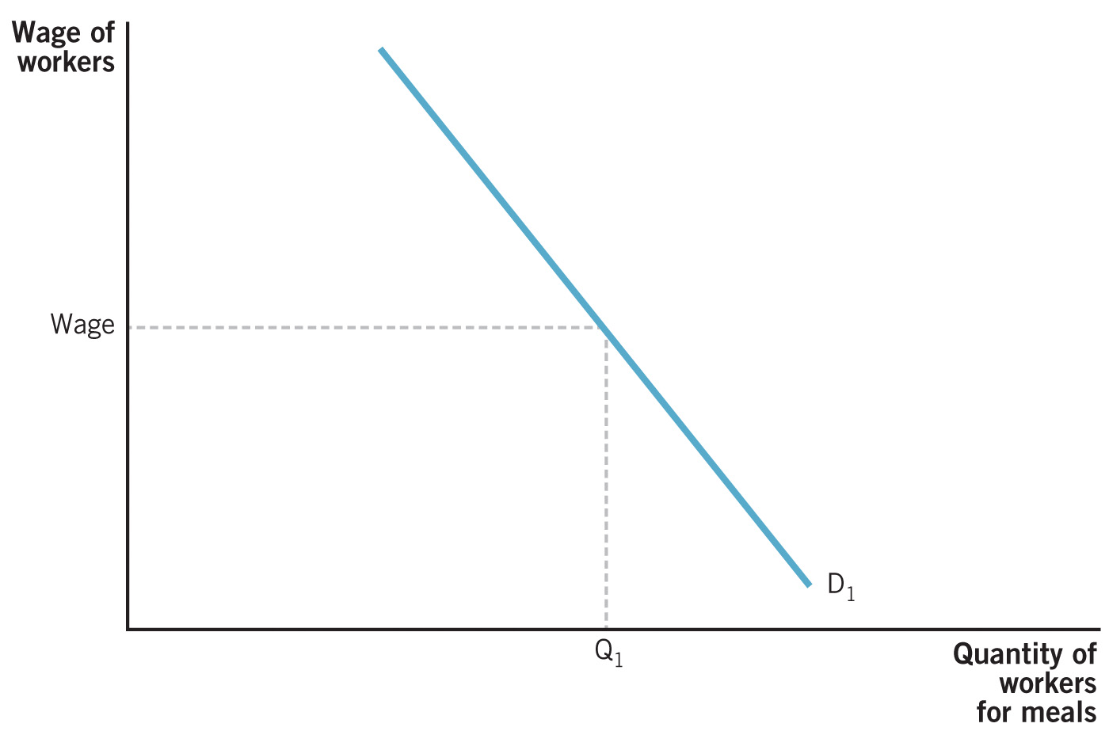



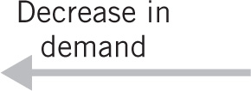

The Labor Demand Curve
Notes:
Image: Animated Figure 14.2
Lecture notes:
The graph starts with an initial demand curve, wage and quantity, Q₁.
First click:
Draws arrow up and down the demand curve.
When the wages of workers change, the quantity of workers demanded, changes.
Suppose that workers productivity improves. What happens to demand?
Second click:
Draws an increase in demand for labor.
Suppose that the demand for the product falls. What happens to demand?
Third click:
Draws a decrease in demand.

Slide 13
Deciding How Many Laborers to Hire—2
Notes:
Lecture notes:
Price of the good being sold is P = $10.
Point out to students again that the VMP columns represents the firm’s demand for labor.
If workers become more productive, MPL increases, and since VMP = P x MPL, VMP increases.
If the demand for a firm’s product increases, price increases, and since VMP = P x MPL, VMP increases.

Slide 14
Economics in Wimbledon
Labor demand
Notes:
“Economics in the Media” Slide
Lecture tip:
The clip mentioned on the slide can be found in the Interactive Instructor’s Guide. Access the direct link by clicking the icon in the PowerPoint above.
This clip is about the increased financial opportunities (greater demand) of Peter Cort, who made the quarterfinals late in his career. The other key concepts covered in this clip are:
Labor demand
Labor markets
Wages

Slide 15
Economics in Johnny Cash’s “The Legend of John Henry’s Hammer”
Life was hard during the Industrial Revolution.
Notes:
“Economics in the Media” Slide
Lecture tip:
The clip mentioned on the slide can be found in the Interactive Instructor’s Guide. Access the direct link by clicking the icon in the PowerPoint above.
This song is about the Industrial Revolution and the effects of technology. You can play it before you discuss the short and long run effects of new technology on workers.

Slide 16

Changes in the Demand for Labor—1
Changes in technology can have two effects:
  New low-cost technology can substitute for workers
  More technology will decrease the demand for labor
Notes:
Lecture notes:
Changes in cost can be positive—for example, a new technology; or negative—for example, an increase in the cost of a needed raw material.
Regarding the photo on the slide:
The logging industry is an example of how capital and technology have greatly replaced the need for labor inputs.

Slide 17
Changes in the Demand for Labor—2
Technology replacing labor: good or bad?
Short run
  May seem bad if workers lose jobs
Long run
  Society benefits! Production is cheaper and safer.
  Workers will hopefully find other jobs, allowing production in other sectors to increase.
  Society is harmed if we tried to save jobs being replaced by technology.
Notes:
Lecture notes:
Changes in cost can be positive—for example, a new technology; or negative—for example, an increase in the cost of a needed raw material.
Economics in real life over time:
This is how economic development works through time.
The most successful countries have moved from simple, low-income economies with a high proportion of jobs in manual labor, to modern, high-income economies by utilizing more capital in the production process to raise the VMP of each worker.
At the same time, the quality of life is improved since workers in modern economies earn more and have safer jobs.
Something to consider:
What if firms continued to use labor for jobs when capital is available?
You may think that’s good because people keep their jobs. But here is what would happen:
If we insisted on using traditional methods to fell trees, we could employ more lumberjacks.
The process of cutting wood would remain expensive and dangerous.
Instead, if we use capital and technology:
Trees can be cut down faster and more safely.
Overall production rises because while one worker harvests trees, nine others are able to move into related fields, or to do something entirely different.
With the use of new technology, one person can now safely produce the same amount that formerly required ten people to risk their lives.

Slide 18
Economics in The Office, “The Initiation”
Free pretzels make more productive workers.
Notes:
“Economics in the Media” Slide
Lecture tip:
The clip mentioned on the slide can be found in the Interactive Instructor’s Guide. Access the direct link by clicking the icon in the PowerPoint above.
The key concept covered in this clip is labor productivity.
You can follow up this clip by asking students the following questions:
Do free perks improve productivity?
Do they improve worker morale?

Slide 19
Where Does the Supply of Labor Come From?
What happens to the quantity of labor supplied as the wage rate increases?
What happens to the supply of labor as factors other than the wage change?
Notes:
Lecture tip:
Start by asking students the two basic questions on this slide.
Note that one question looks at slope of the supply curve.
The other question looks at a shift in the supply curve.

Slide 20
Labor-Leisure Trade-off—1
If wages rise, will you work more or less?
Two effects:
  Substitution effect
    occurs when laborers work more hours at higher wages: substituting labor for leisure
  Income effect
    occurs when laborers work fewer hours at higher wages: with additional income they demand more leisure, so they work fewer hours
Notes:
Lecture notes:
On Tradeoff:
The supply of labor depends on the wage and on how people want to use their time.
Two effects:
Think of leisure as a “good” you buy.
The price of one hour of leisure is your wage, since the opportunity cost of one hour of leisure is one hour of work.
So as your wage increases, the quantity of labor demand decreases.
You “buy” less leisure, so you work more.
But, leisure is a normal good.
So when your wage increases, all else equal, your income goes up.
So you can “buy” more leisure, and you work less.

Slide 21
Labor-Leisure Trade-off—2
Which effect dominates?
At relatively lower wages:
  The substitution effect dominates:
  Higher wages lead to more working hours because the cost of leisure has risen.
At relatively higher wages:
  The income effect dominates
  Higher wages lead to fewer working hours because a high level of income can be maintained resulting in more leisure hours.
Notes:
Lecture tip:
Make sure students understand that both effects are present.
Generally, the substitution effect is stronger than the income effect.
If SE > IE, it means that people will work more hours when wages are increased.
If SE < IE, it means that people will work less hours when wages are increased.

Slide 22
The Labor Supply Curve
Q’
Notes:
Image: Animated Figure 14.3
Lecture notes:
The figure on the slide starts with a typical upward sloping supply curve.
As it is drawn right now, the SE > IE for all wages.
Suppose as wages increase above W₁, the income effect starts to get stronger, and at W₂ the IE > SE. What happens to the supply curve?
Click: Draws backwards bending supply curve.
Once wages increase above W₂, the quantity of labor supplied starts to fall below Q’.

Slide 23
Changes in the Supply of Labor
What factors will cause the labor supply curve to shift?
Other job opportunities
Change in the composition of the workforce
Migration and immigration
Notes:
Lecture tip:
Remind students, that we now hold wages constant.
Other employment opportunities:
If workers are mobile, they’ll generally want to go where wages are higher (assuming the job qualifications and tasks are similar).
This can sometimes lead to “labor raiding” where one company tries to steal away workers from another company with the lure of higher wages.
Changing composition of workforce:
Increasing the retirement age would also increase the number of workers.
Migration and immigration:
Southern and western states accounted for 84% of the nation’s population growth from 2000 to 2010, with Nevada, Utah, North Carolina, Idaho, and Texas all adding at least 20% to their populations.

Slide 24
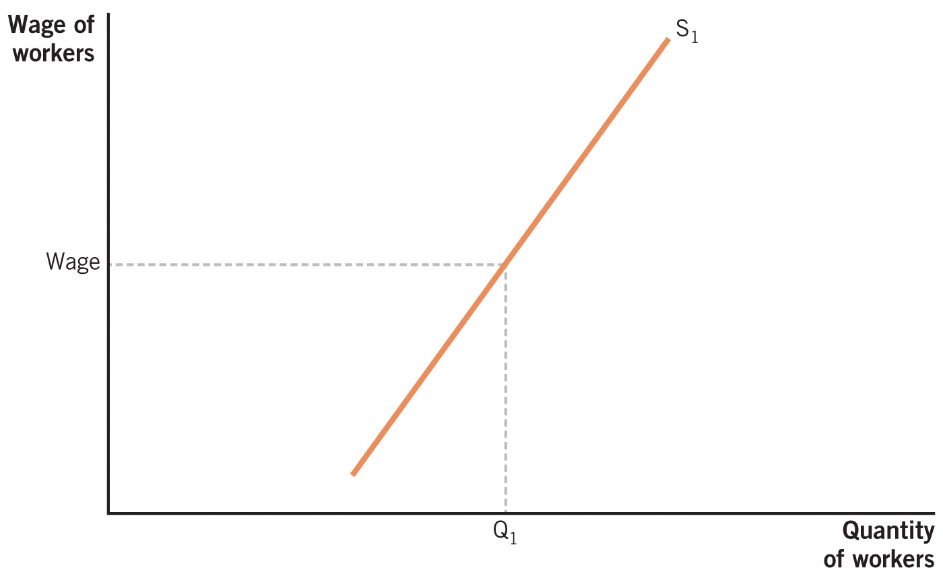



The Supply of Grocery Store Baggers
Notes:
Image: Animated Figure 14.4
Lecture notes:
The graph on the slide starts with an initial supply curve, wage and quantity, Q₁.
First click:
Draws arrow up and down the supply curve.
When the wages of workers change, the quantity of workers supplied, changes.
Now suppose that the wages of workers decreases.
What should happen to the supply of baggers?
Second click:
Draws new supply curve at S₂.
The supply of busboy should increase, since their wages are now relatively higher than baggers.
Note that this example implies that the skills for both jobs is roughly the same.

Slide 25


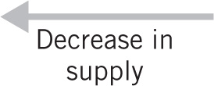
The Supply of Nurses
Notes:
Image: Animated Figure 14.4
Lecture notes:
The graph on the slide starts with an initial supply curve, wage and quantity, Q₁.
First click:
Draws arrow up and down the supply curve.
When the wages of workers change, the quantity of workers supplied, changes.
Suppose that there is a decrease in the number of people with a nursing degree in the workforce.
What would happen to the supply of nurses?
Second click:
Draws new supply curve at S₃.
The supply of nurses should decrease.

Slide 26
Economics in A Day without a Mexican
What would happen to California if all the Latinos in the state suddenly disappeared?
Notes:
“Economics in the Media” Slide
Lecture tip:
The clip mentioned on the slide can be found in the Interactive Instructor’s Guide. Access the direct link by clicking the icon in the PowerPoint above.
The key concepts covered in this slide are:
Economic growth
Labor markets
Trade barriers
Immigration
The answer to the question posed on the slide is: The state economy would come to a halt.

Slide 27
Labor Market Equilibrium—1
Let’s put demand and supply together.
If the labor market is in equilibrium:
  At the current wage the quantity of labor demanded is equal to the quantity of labor supplied
If there is a surplus of labor: Qs > Qd.
If there is a shortage of labor: Qd > Qs.
Wages should adjust to eliminate any surplus or shortage.
Notes:
Lecture notes:
Quantity supplied of labor illustrates how many workers are willing to work at various wages.
Quantity demanded of labor illustrates how many workers firm is willing to hire at various wages.
Once again, the equilibrium in this market is a stable equilibrium. Without any interference, the wage rate will move toward the equilibrium wage due to the forces of supply and demand.

Slide 28
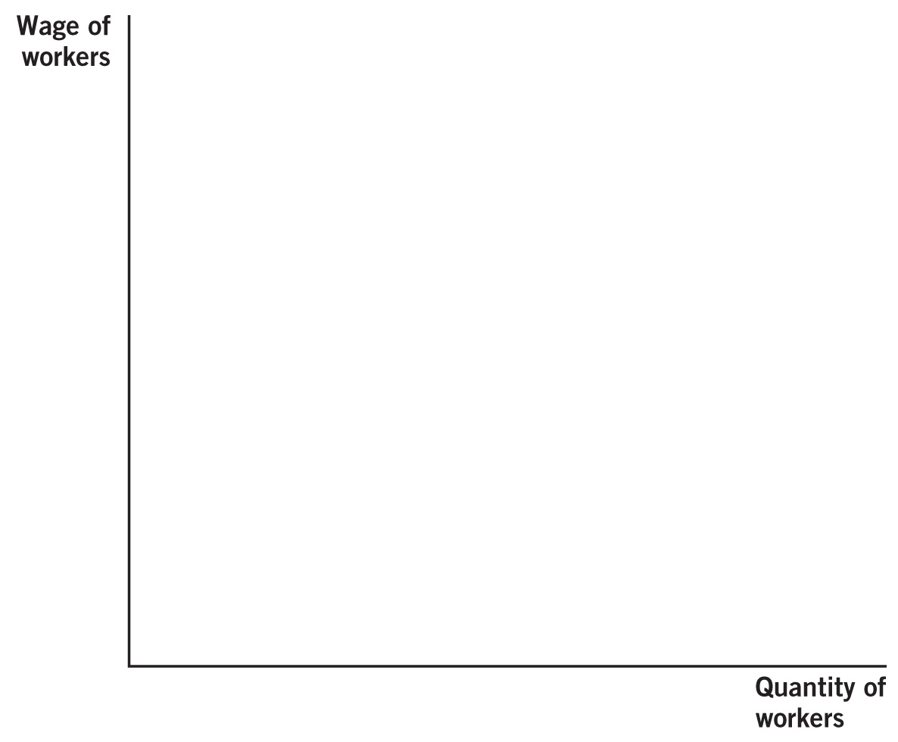








Labor Market Equilibrium—2
Notes:
Image: Animated Figure 14.5
Lecture notes:
First click:
Adds W_{low}
At this wage, what’s the problem in the market? What will happen?
Second click:
Adds “Shortage” and up arrows.
At low wages a shortage occurs. A shortage forces the wage rate up until the equilibrium wage is reached and the shortage disappears.
Third click:
Add W_{high}
At this wage, what’s the problem in the market? What will happen?
Fourth click:
Adds “Surplus” and down arrows.
At high wages there is a surplus of workers. A surplus forces the wage down until the equilibrium wage is reached and the surplus disappears.

Slide 29
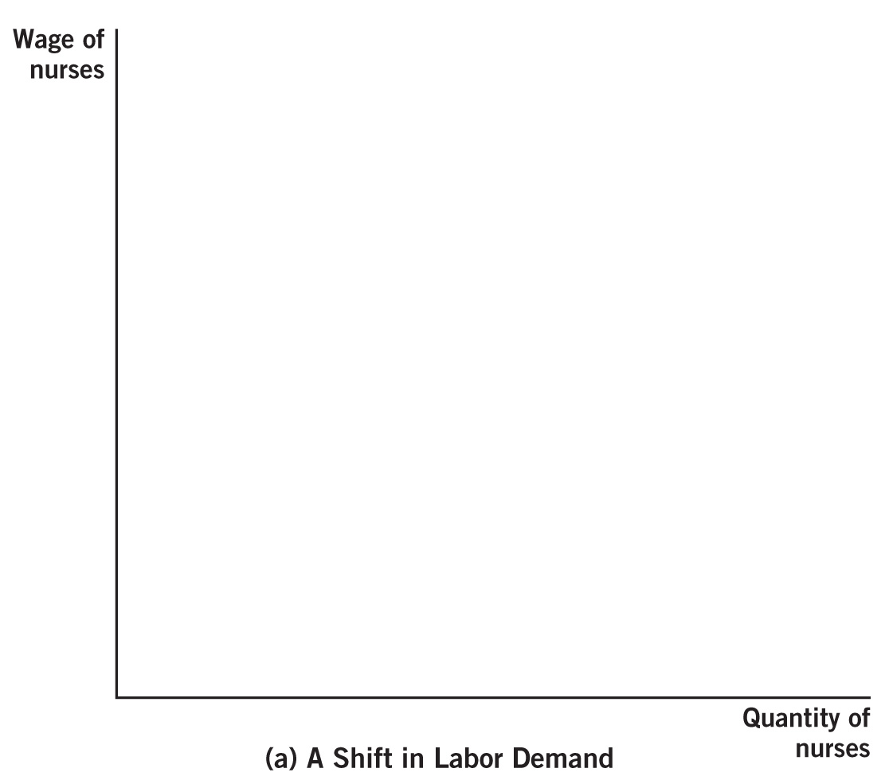



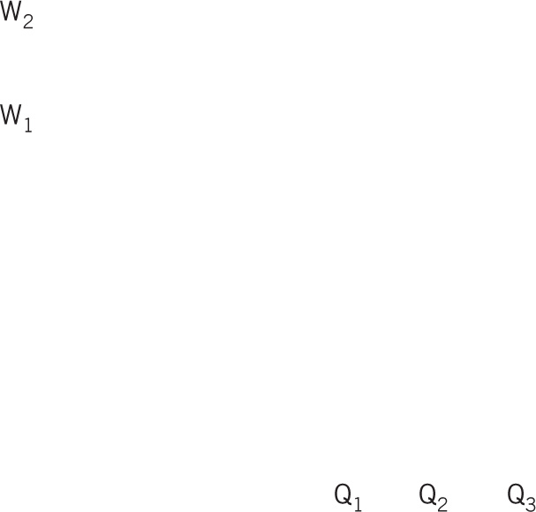



Changes in Equilibrium—1
Notes:
Image: Animated Figure 14.6.a
Lecture notes:
The graph on the slide starts with market in equilibrium at W₁ and Q₁.
Imagine that demand for medical care increases due to an aging population.
First click:
The demand for nurses increases and the demand curve shifts from D₁ to D₂.
Second click:
Labels shortage at W₁.
The shortage of workers places upward pressure on wages, which increase from W₁ to W₂.
As wages rise, nursing becomes more attractive; additional people go into nursing and existing nurses decide to work longer hours or postpone retirement.
Third click:
Labels new equilibrium.
Eventually, the wage settles at E₂ and the number of workers employed ends up at Q₂.

Slide 30
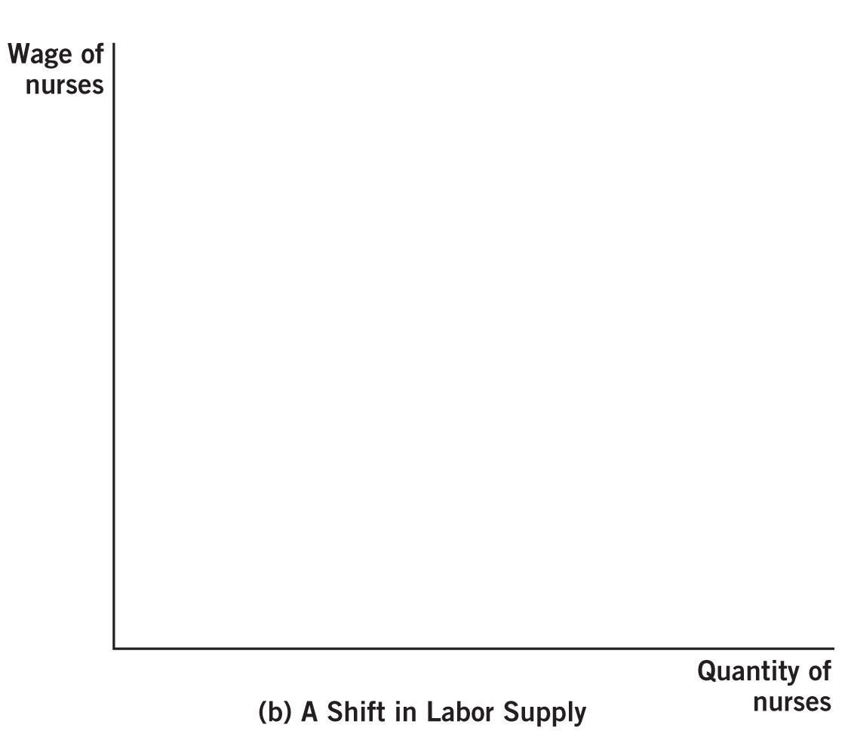
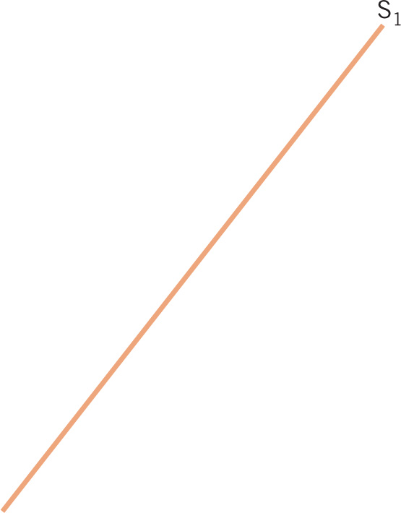

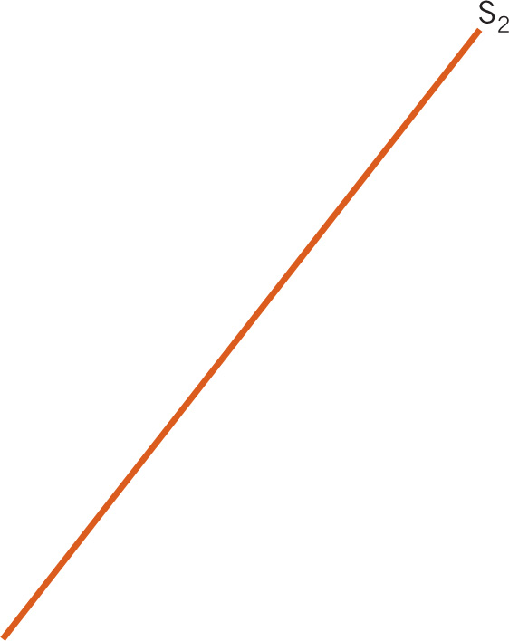

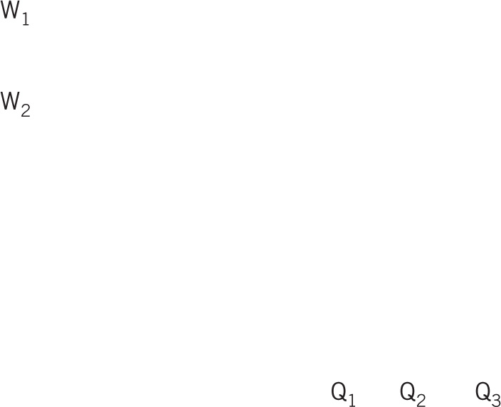




Changes in Equilibrium—2
Notes:
Image: Animated Figure 14.6.b
Lecture notes:
The graph on the slide starts with market in equilibrium at W₁ and Q₁.
What happens when the supply of nurses increases?
First click:
Labels new supply curve.
As additional nurses are certified the overall supply shifts from S₁ to S₂.
Second click:
Labels surplus.
A surplus of workers at W₁ places downward pressure on wages.
Third click:
Labels new equilibrium.
Eventually, the market wage settles at W₂, at the new equilibrium point E₂, and the number of workers employed ends up at Q₂.

Slide 31
Practice What You Know—1
What could lead to a backward-bending labor supply curve?
  The income effect dominating the substitution effect at high wages
  The substitution effect dominating the income effect at high wages
  Laborers always working more hours when wages are higher
  Firms choosing to hire fewer workers when market wages are higher
Notes:
Clicker question:
Correct answer: A, The income effect dominating the substitution effect at high wages
With regards to labor supply (remember that YOU are a supplier of labor!)
Substitution effect:
If wages rise, people may be willing to work more hours because the opportunity cost of leisure is now higher.
Sub in labor, sub out leisure.
Income effect:
If wages rise, people may be willing to work less hours because you could earn the same total income amount working fewer hours, and enjoy more leisure hours.
You use your extra income to purchase more leisure (a normal good).

Slide 32
Practice What You Know—2
The demand for labor will increase if
  the wage rate decreases.
  there is a decrease in the number of firms hiring.
  the demand for the product produced by the labor increases.
  labor becomes less productive.
Notes:
Clicker question:
Correct answer: C, the demand for the product produced by the labor increases.
If people want more of good “X,” then firms will need more laborers to produce good “X.”
Why is the answer not A?
Answer A illustrates a movement along the labor demand curve, rather than a shift.

Slide 33
Practice What You Know—3
A firm will keep hiring workers as long as the wages paid to workers is less than the
  wages the workers could earn elsewhere.
  price of the goods being produced.
  marginal Product of Labor (MPL).
  value of Marginal Product (VMP).
Notes:
Clicker question:
Correct answer: D, value of Marginal Product (VMP).
For the firm, the comparison is this:
How much is the worker costing me (wages) versus how much revenue is he bringing me (VMP)? If the worker produces outputs that can be sold for VMP greater than what the worker is costing the firm, the firm will employ that worker.

Slide 34

Economics in Outsourced
After his entire department is outsourced, an American novelty products salesman from Seattle heads to India to train his replacement.
Notes:
“Economics in the Media” Slide
Lecture tip:
The clip mentioned on the slide can be found in the Interactive Instructor’s Guide. Access the direct link by clicking the icon in the PowerPoint above.
The key concepts covered in this clip are:
Outsourcing
Marginal revenue product
Efficiency gains
Ask your students if they are willing to pay more for a product that is manufactured in the United States.
Does their answer depend on what the product is or how much more they would pay?
[OUTSOURCED, Josh Hamilton, Ayesha Dharker, 2006/The Everett Collection, Inc.]

Slide 35
Economics in “Big Box Mart”
If all U.S. manufacturing jobs are outsourced to the “slums of Beijing,” the only place U.S. workers will be able to find work is at big-box stores.
Notes:
“Economics in the Media” Slide
Lecture tip:
The clip mentioned on the slide can be found in the Interactive Instructor’s Guide. Access the direct link by clicking the icon in the PowerPoint above.
The key concepts covered in this clip are:
Outsourcing
Unemployment
Cost of production
Ask your students if they are willing to pay more for a product that is manufactured in the United States.
Does their answer depend on what the product is or how much more they would pay?

Slide 36

Outsourcing
Outsourcing
  Occurs when a firm shifts jobs to an outside company, usually overseas, where the cost of labor is lower
Notes:
Lecture notes:
Outsourcing may be politically unpopular. A firm may consider the costs of NOT outsourcing (higher labor expenses) to the benefits of NOT outsourcing (proud “made in America” labels), which may sway demand for some consumers.
[GRAND AVENUE ©2003 Steve Breen and Mike Thompson. Reprinted by permission of Universal Uclick for UFS. All rights reserved.]

Slide 37
Global Implications—1
Short Run
  Outsourced jobs are not “lost” – they relocate.
  Firms produce goods at lower costs, and consumers get goods at lower prices.
  Need to think about the total effects of outsourcing.
  Germany built a plant in Tennessee. Is this good or bad for the United States?
Notes:
Lecture notes:
Jobs are relocated from high cost to low cost areas.
While the U.S. loses domestic employment for jobs sent overseas, we gain employment from countries outsourcing to the U.S. It’s not a one-way path.

Slide 38
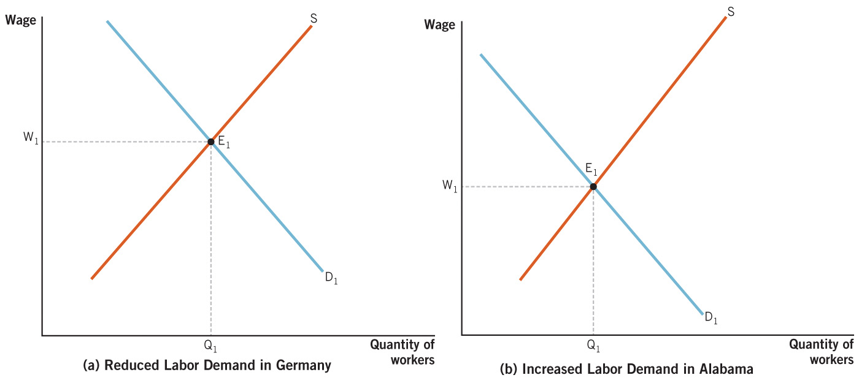




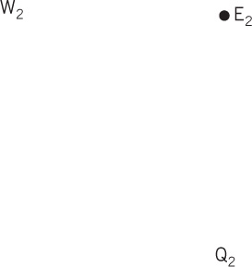

Shifting Labor Market Equilibrium
Notes:
Image: Animated Figure 14.7
Lecture notes:
The graphs on the slide start at equilibrium in both countries (wages in Germany are higher than in Alabama).
First click:
Demand for German workers falls.
When Germany moves production to the U.S. the demand for German workers falls.
Second click:
Demand for U.S. workers rises.
and the demand for US worker increases.
Third click:
Labels new equilibrium in both countries.
Wages and employment in Germany fall.
Wages and employment in US rise.

Slide 39
Global Implications—2
Long Run
  Outsourcing allows for greatest specialization and increases efficiency
  Both firms and consumers gain.
  Trade creates value.
Notes:
Lecture tip:
You may want to ask students here why they think it would be more important that an American they do not know has a job and a foreigner who they do not know does not have a job.
Why is the welfare of the American more important than that of a foreigner to some people?
You could relate outsourcing to technological change, since they can have similar short-run and long-run effects.
In the short-run, outsourcing does harm those who lose their jobs. However, in the long run, we benefit.

Slide 40
Economics in “John Stossel– Outsourcing”
Paradoxically, companies that outsource jobs actually create the most jobs in America: they save money by outsourcing, allowing them to expand.
Notes:
“Economics in the Media” Slide
Lecture tip:
The clip mentioned on the slide can be found in the Interactive Instructor’s Guide. Access the direct link by clicking the icon in the PowerPoint above.
The key concepts covered in this clip are:
Outsourcing
Globalization
In this clip, Stossel offers a defense of globalization.

Slide 41
Practice What You Know—4
Which of the following is a true statement about outsourcing?
  Outsourcing generally helps the firm by raising the price of the goods sold.
  Outsourcing may decrease wages for domestic workers.
  Outsourcing will decrease the overall supply of workers that a firm can employ.
  There are no significant economic trade-offs with regard to outsourcing.
Notes:
Clicker question:
Correct answer: B, Outsourcing may decrease wages for domestic workers.
One reason why people may not like outsourcing (especially at a global level) is because it may lower wages. If someone in a foreign country is willing to do your job at lower pay, the firm will higher the cheaper input. If you are not willing to do the job for the same low pay, the firm may no longer use you as an input.

Slide 42
Monopsony
Monopsony
  A market situation in which there is only one buyer
Monopsony results
  Monopsonist has market power so can push prices down
  Monopsonist labor buyer will push wages low
Notes:
Lecture tip:
The text uses an example of small isolated college town:
If the college is the main source of employment it has market power and can keep wages low.
You could also discuss monopsony power in the context of the minimum wage.
Before we showed that a binding minimum wage leads to unemployment. This is true if the market is competitive.
If there is a monopsony hirer of unskilled workers, a minimum wage could actually increase the number of jobs.

Slide 43

Monopsony and the WNBA
NBA
  Teams are all owned separately
  Many competing purchasers of NBA labor
  Higher wages
  Average salary of NBA player in 2011
  was $5.15 million
WNBA
  At first, teams are all owned by the NBA
  One purchaser of WNBA labor (monopsony)
  Lower wages
  Salary cap for WNBA TEAM in 2013 was $869,000
Notes:
“Beyond the Book” Slide
Sources:
www.nba.com/2011/news/features/steve_aschburner/08/19/average-salary/index.html
www.altiusdirectory.com/Sports/wnba-salaries.php
Lecture tip:
You could also discuss other factors such as a lower derived demand for WNBA players (not as many people want to watch WNBA compared to NBA).
However, monopsony power plays a large role in the striking difference between player salaries among the two leagues.

Slide 44
Class Activity: Think-Pair-Share: What Determines Salary?
Get into groups and discuss what determines salary.
Should “important” jobs, such as teaching, nursing, and social work, be well remunerated?
Should star athletes earn millions of dollars per year?
Notes:
Classroom activity: Think-Pair-Share: Marginal Revenue Product of Labor and Social Work in Humans of New York (See Tip #504)
Ask students to get into groups to discuss the scenario in this Tip.

Slide 45
Why Do Some Workers Make More Than Others?—1
Question | Answer
Why do economists generally earn more than elementary school teachers? | Supply side – fewer qualified economists than certified elementary school teachers. Demand side - value of the marginal product of labor of economists is generally higher than that of most elementary school teachers.
Why do people who work the night shift earn more than those who do the same job during the day? | Supply side - Fewer people are willing to work at night, so the wage necessary to attract labor to perform the job must be higher.
Notes:
Lecture tip:
See if students can give you some answers before you click through the slide to reveal each empty column. Ask them to think of both demand and supply reasons.

Slide 46
Why Do Some Workers Make More Than Others?—2
Question | Answer
Why do athletes and actors make so much when what they do is not essential? | Demand side – The paying public is willing to spend a large amount of income on entertainment. Supply side - the number of individuals with the skills and talent to capture the paying public is very small.
Why do janitors, construction workers, nurses—whose jobs are essential—have salaries that are a tiny fraction of celebrities’ salaries? | Demand side - the value of the marginal product of labor created in these essential jobs is low, so their employers are unable to pay high wages.
Notes:
Lecture tip:
See if students can give you some answers before you click through the slide to reveal each empty column. Ask them to think of both demand and supply reasons.

Slide 47
The Market For Other Production Factors—1
Market for land
  How is the supply of land different than other factors of production?
  How would an increase in demand for land affect price and quantity?
Notes:
Lecture notes:
Supply of land is fixed, so supply is perfectly inelastic (vertical).
Increases in demand result in price increases, but not quantity increases

Slide 48
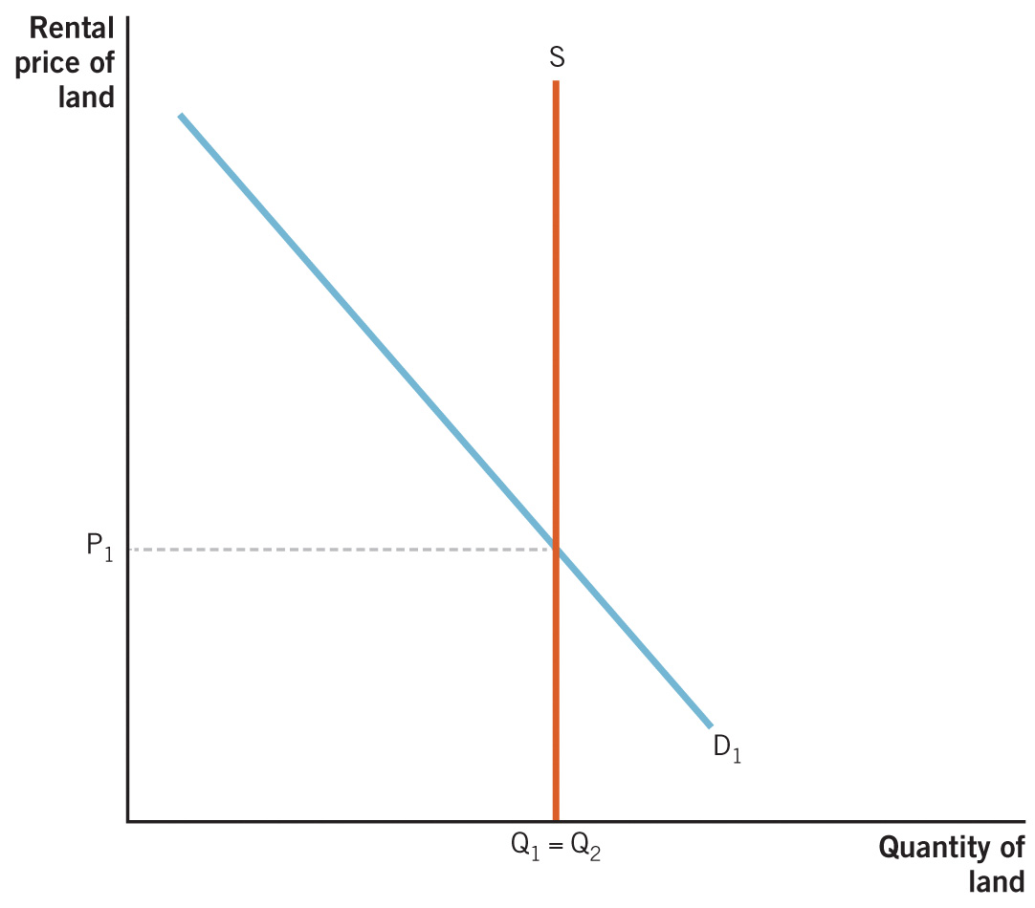

Supply and Demand for Land
Notes:
Image: Animated Figure 14.8
Lecture notes:
Since the supply of land is fixed, the price it commands depends on demand.
First click:
Demand increases.
If demand increases from D₁ to D₂, the price will rise from P₁ to P₂.
But quantity remains at Q₁.

Slide 49

The Market for Land—1
Economic rent
  The difference between what a factor of production earns and its next-best alternative
  Ability of investors to beat their opportunity costs
Economic rent example
  Apartment near campus has higher price than apartment 10 miles from campus
  Higher demand for living near campus
Notes:
[© R. Gino Santa Maria | Dreamstime.com]

Slide 50

The Market for Land—2
Build it and they will buy.
Notes:
Lecture notes:
Regarding the photo on the slide:
An interesting exception to the idea of a fixed supply of land.
Nakheel Properties, a real estate developer in Dubai, built several artificial islands and land extensions in the Persian Gulf.
Waterfront property was so valuable, the firm found it worthwhile to artificially create more of it!
[MCT/Newscom]

Slide 51

The Market For Other Production Factors—2
Market for capital
  Like labor, demand for capital is a derived demand
  Determined by the value of marginal product of capital
  Downward sloping:
  MPK declines with
  increased amounts of
  capital employed
Notes:
Lecture notes:
Marginal Product of Capital (MPK) is diminishing when we assume a fixed amount of labor. If we keep adding capital (buildings, machines, computers, etc.) but don’t add workers, we’ll eventually get to a point where the additional output produced by the additional capital will start to diminish.
[© Lucian Coman | Dreamstime.com]

Slide 52
When to Use More Labor, Land, or Capital—1
How does a firm determine the best use of its resources?
  Compare the value of the marginal product per dollar spent on each resource
  Compare the VMPL/wage to VMPK/price of capital
  Maximize their “bang for their buck.”
Notes:
Lecture notes:
A firm would want to use the resource that provides it with the greatest value of marginal product per dollar spent.

Slide 53
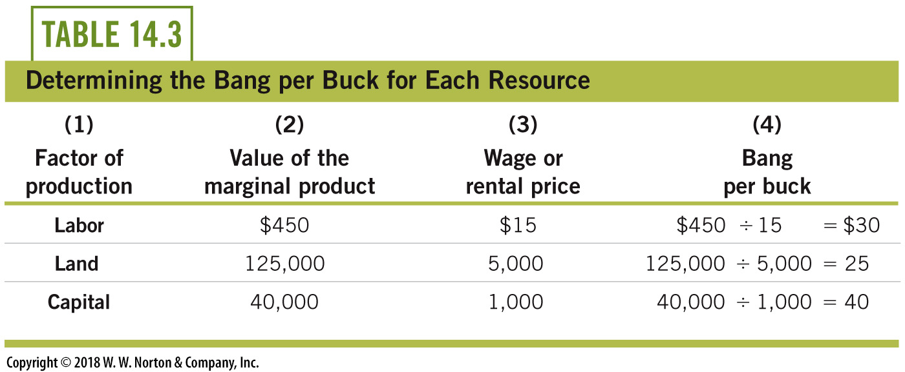
Land, Labor, Capital Example
Which resource should the firm use more of? Which resource should it use less of?
What happens as the firm uses more of one resource, and less of another?
Notes:
Lecture tip:
Go over each part of the table with students.
Point out that both the productivity of the input and the price of the input matter.
When the firm compares VMP per dollar, they are considering how much revenue they can earn from one dollar spent on a resource.
In this problem the firm should use more capital and less land.
As the firm uses more capital, its marginal product, and its bang for buck falls.
As the firm uses less land, its marginal product, and its bang for buck rises.

Slide 54
When to Use More Labor, Land, or Capital—2
How does a firm determine the best use of its resources?
  Compare the value of the marginal product per dollar spent on each resource.
  Compare the VMPL/wage to VMPK/price of capital
  Maximize their “bang for their buck.”
A firm is using its resources efficiently when the value of the marginal product per dollar is equal for each resource.
Notes:
Lecture tip:
Point out to students that the amount of labor a firm uses is not only a function of the marginal product of labor but also the marginal product of land and capital.
A change in the supply of one factor will affect the return or all factors employed.
If the price of capital falls, all else equal, firms would want to use more capital and use less land and labor.
It also depends on the marginal product of land and capital.
Therefore, a change in the supply of one factor will alter the returns of all factors.
For instance, falling wages will induce firms to hire more labor, and simultaneously use less capital to produce goods. Capital itself is not any more, or less, productive. Rather, lower wages reduce the demand for capital.

Slide 55
Conclusion—1
The demand for each factor of production is derived from the value of the factor’s marginal product.
The supply of labor depends on the wage rate that is offered, and also on each person’s goals and other opportunities.
At high wage levels the income effect may become larger than the substitution effect and cause the supply curve to bend backward.

Slide 56
Conclusion—2
Labor markets reconcile the forces of demand and supply into a wage signal that conveys information to both sides of the market
If there is a surplus (shortage) of available workers at the current wage, wages will fall (rise)
Changes in the demand and/or supply of labor will cause the market wage and quantity to change.

Slide 57
Conclusion—3
In the short run, outsourcing could lead to an increase or decrease in employment.
In the long run, outsourcing increases the overall productivity of workers everywhere.
A monopsonist in the labor market is able to leverage market power by paying workers less.
Economic rent is the difference between what a factor of production earns and what it could earn in the next-best alternative.
Notes:
Lecture notes:
The efficient mix of resources used by a firm occurs when the value of the marginal product per dollar for each resource are equal.

